Slide 1
ORGANISATIONAL
BEHAVIOUR
CHAPTER-20
ORGANISATIONAL CHANGE AND DEVELOPMENT

Slide 2
LEARNING OBJECTIVES
The nature, levels, need, and types of change.
The reasons for change in organisations.
The reasons why people resist change.
The change process.
The nature of OD and the various techniques of OD.

Slide 3
Nature of Change
        vital if a company were to avoid stagnation;
        a process and not an event;
        normal and constant;
        fast and is likely to increase further in the present competitive business;
        ‘directive’, that is, implemented by ‘top down’ management or ‘participative’, that is, involving those parties impacted by change;
        is ‘natural’, that is, evolutionary or ‘adaptive’, that is, a reaction to external circumstances and pressures;
        is ‘incremental’, that is continuous small changes or ‘step’, that is, radical shift from current to new processes; and
        is interdependent on organizational environment or culture.³

Slide 4
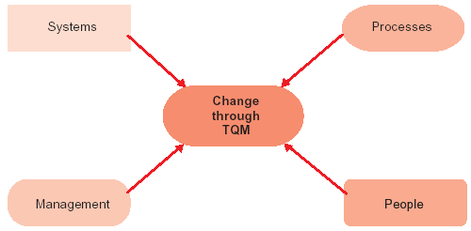
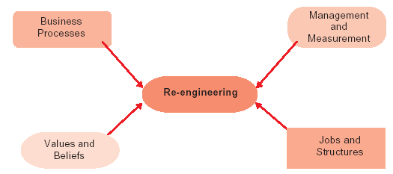
Components of Change – Through TQM
Components of Re-engineering

Slide 5
Causes for Change
External causes Internal causes
Globalization Organisational silence
Workforce diversity Falling effectiveness
Technological change Crisis
Managing ethical behaviour Changing employee expectations
Government politices Change in the work climate
Competition
Scarcity of resources

Slide 6
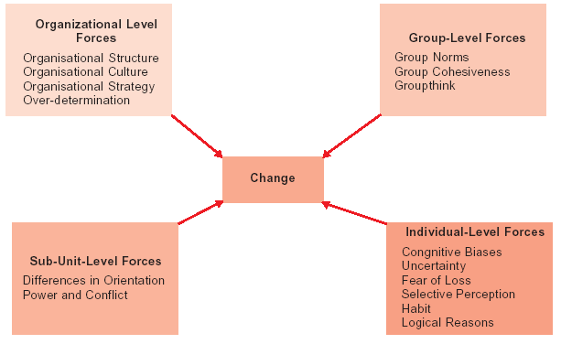
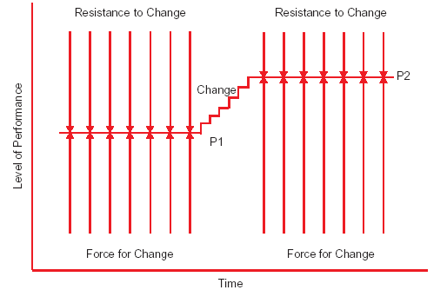
Sources of Resistance to Change
Lewin’s Force Field Theory of Change

Slide 7
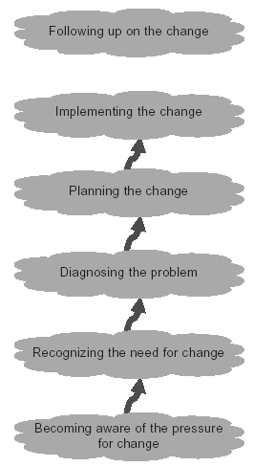

The Six-Stage Change Process

Slide 8
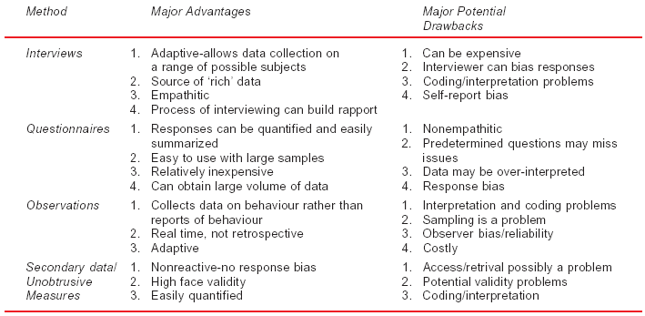
A Comparison of Four Diagnosis Methods

Slide 9
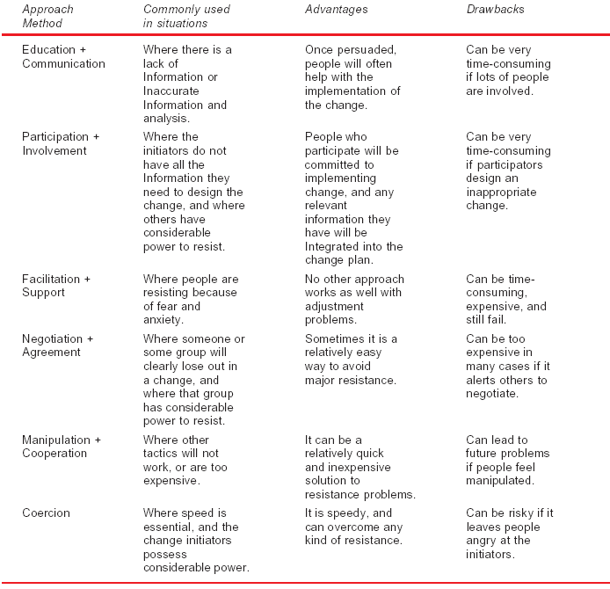
Six Methods for Dealing With Resistance to Change

Slide 10
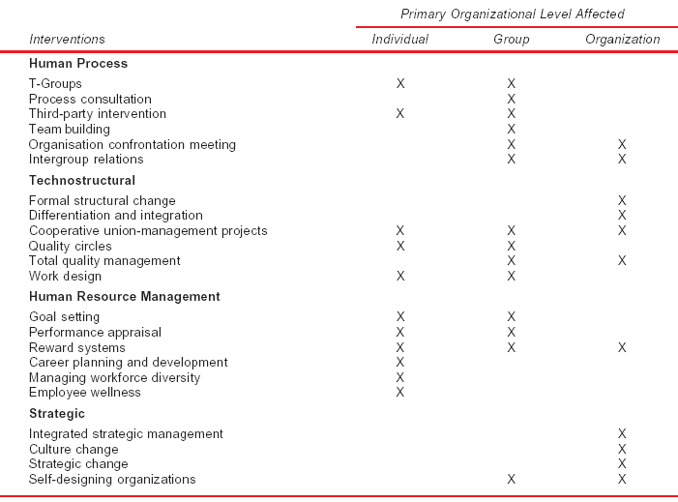
Examples of OD Interventions and the Organisational Levels they Impact

Slide 11
T-GROUP TRAINING INSTITUTIONS IN INDIA
Year Individual Institution Focus Area
1971 ISABS NTL approach: Intra-personal, inter-personal and group processes-based sensitivity training.
1979 Indian Society for Individual Departure:Role and identity based sensitivity and Social Development training-broader perspective including mythology, existential, eastern, phnem-
nological and relativists philosophies.
1996 Aastha Role and identity-based sensitivity training-focus on educational sector.
1996 Sumedhas:The Academy of Role and identity based sensitivity training- Human Context invitation rather than confrontation and unfolding of self in its wholeness.

Slide 12
Team Building Activities
Activity Family Groups Special Groups
Diagnosis Diagnostic meetings:’How are Diagnostic meetings:’Where We doing?’ would you like to go?’
Task accomplishment Problem solving, decision making, Special problems, role and role clarification, goal setting, etc. goal clarification resource utilization, etc.
Building and maintain- Focus on effective interpersonal Focus on interpersonal or
ing relationships relationships, including boss-sub- inter-unit conflict and ordinate and peer underutilization of other team members as resources.
Management of group Focus on understanding group Focus on communication, processes processes and group culture decision making, and task allocations.
Role analysis and role Technique used for clarification Technique used for role negotiations and definition clarification and definition.

Slide 13
Summary
Organisational change is the process through which an organisation moves from the present state to an improved state. Change is vital for organisation’s survival.
Change management comprises three elements: evolution of the firm, its management and organisation, and the people who work for it.
Three levels of change are observed: individual level, group level, and organisations.
Evolutionary change and revolutionary change are the types described in the literature on change management. While TQM represents the former, reengineering typifies the latter.
External and internal forces force change in organisations.
Generally change is resisted because of organisational, group, sub-unit and individual forces.
Lewin’s Force Field theory explains how change occurs in organisations.
Change is a six-step sequential process.
OB experts have designed several OD techniques to make change systematic and meaningful. OD techniques can be classified under four heads: human process, technostructural, HRM, and strategic.
Change management has several managerial implications-the main lesson is that the managers cannot rest on past laurels. They need to change in tune with the changing times.

Slide 14
Key Terms
Organisational change
TQM
Change agent
Resistance to change
Action Research
Grid training
QWL
Change management
Reengineering
Transition management
Six-stage change process
Team building
Sensitivity training

